Slide 1
CPSC 583 Expert Systems Design Theory
Dr. Anand Panangadan
apanangadan@fullerton.edu

Slide 2
Wumpus world
4x4 grid world
In the squares adjacent to the wumpus, you will get a stench
In the square adjacent to a pit, you will feel a breeze
In the square where the gold is, you will see a glitter
You die if you enter a square containing a pit or a wumpus
You can move one step in any direction
Start from (1,1)
Goal:
Move through the grid to get the gold without getting killed (by either the wumpus or pit)

Slide 3
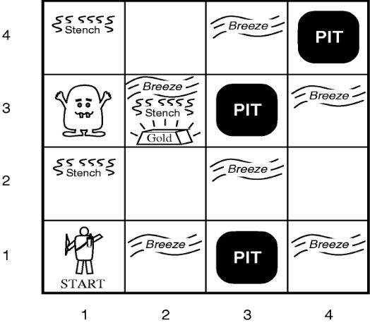

Slide 4
Wumpus world logic
if you sense a stench, then you knows the wumpus must be in the front or left or right square.
if you feel a breeze, then it knows the PIT must be in the front or left or right square.
if no stench and no breeze, all directly adjacent squares are safe.

Slide 5
Wumpus world logic
Develop a propositional logic system to decide where to move

Slide 6
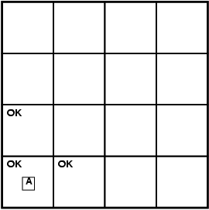
Exploring a wumpus world

Slide 7
Exploring a wumpus world

Slide 8
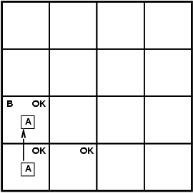
Exploring a wumpus world

Slide 9
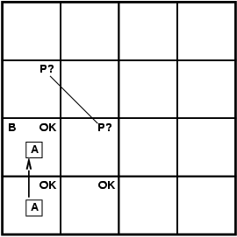
Exploring a wumpus world

Slide 10
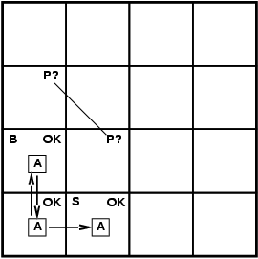
Exploring a wumpus world

Slide 11
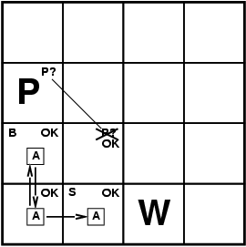
Exploring a wumpus world

Slide 12

Exploring a wumpus world

Slide 13
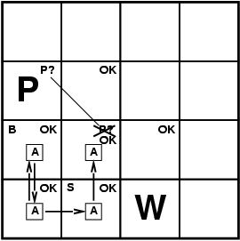
Exploring a wumpus world

Slide 14
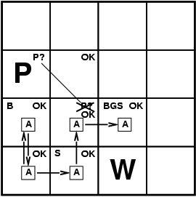
Exploring a wumpus world

Slide 15
Wumpus world characterization
Fully Observable
No – only local perception
Deterministic
Yes – outcomes exactly specified
Static
Yes – Wumpus and Pits do not move
Discrete
Yes
Single-agent?
Yes – Wumpus is essentially a natural feature

Slide 16
Imperative/procedural programming
An approach to programming where the program is a sequence of statements
C++, Python, …
Imperative programming focuses on describing how a program operates

Slide 17
Declarative programming
Inference engine
Domain-independent algorithms
Knowledge base (KB)
Domain-specific content (facts)
Knowledge base = set of sentences in a formal language
Declarative approach to building an agent:
Tell it what it needs to know
Then it can Ask itself what to do - answers should follow from the KB

Slide 18
Some Knowledge Representation Languages
Propositional Logic
Predicate Calculus
Description Logics
Semantic Networks
Nonmonotonic Logic
Frame Systems
Influence Diagrams
Concept Description Languages
Rules with Certainty Factors
Bayesian Networks

Slide 19
Some Knowledge Representation Languages
All popular knowledge representation systems are a subset of
Logic
Either Propositional Logic
Or Predicate Calculus
Probability Theory
E.g., Bayesian networks

Slide 20
Basic Idea of Logic
By starting with true assumptions, you can deduce true conclusions.
Algorithm
Sentences
Sentences
Knowledge Representation
World
Follows
Facts
Facts
Notes:
But what is TRUTH?

Slide 21
Propositional logic
Symbolic logic for manipulating propositions
Can be classified as either TRUE or FALSE
Logical constants: true, false
Propositional symbols: P, Q, S, ... (atomic sentences)
Wrapping parentheses: ( … )
Sentences are combined by connectives:
∧ ...and [conjunction]
∨ ...or [disjunction]
→...implies [implication / conditional]
↔..is equivalent [biconditional]
~ ...not [negation]
Literal: atomic sentence or negated atomic sentence

Slide 22
Examples
P
~Q
Q → P
(P ∧ Q) → R

Slide 23
Syntax
A sentence is defined as follows:
A symbol is a sentence
If S is a sentence, then ~S is a sentence
If S is a sentence, then (S) is a sentence
If S and T are sentences, then (S ∨ T), (S ∧ T), (S → T), and (S ↔ T) are sentences
A sentence results from a finite number of applications of the above rules
Well formed formula (WFF)

Slide 24
Semantics
User defines the set of propositional symbols: P, Q, …
User defines the semantics (meaning) of each propositional symbol:
P means “It is hot.”
Q means “It is humid.”
R means “It is raining.”
(P ∧ Q) → R
“If it is hot and humid, then it is raining”
Q → P
“If it is humid, then it is hot”

Slide 25
Syntax: which arrangements of symbols are legal sentences
“Well-formed formulae”
Semantics: what the symbols mean in the world
(Mapping between symbols and worlds)
Inference
Sentences
Sentences
Representation
Semantics
Semantics
World
Follows
Facts
Facts
Notes:
But what is TRUTH?

Slide 26
Truth tables
A | ~A
T | F
F | T
A | B | A ∨ B
T | T | T
T | F | T
F | T | T
F | F | F
A | B | A ∧ B
T | T | T
T | F | F
F | T | F
F | F | F
A | B | A → B
T | T | T
T | F | F
F | T | T
F | F | T

Slide 27
Truth value of a sentence
Given the truth values of all symbols in a sentence, it can be “evaluated” to determine its truth value (True or False).
Truth table
P
~P
P ∧ Q
Q → P
(P ∧ Q) → R

Slide 28
Knowledgebase (KB) with Propositional Logic
KB contains a set of propositional logic formulae that are known to be true
The premises
Are there other formulae that are also true given this specific KB?

Slide 29
Logical Entailment
Entailment: KB ╞ Q
Q is entailed by KB if and only if :
the conclusion is true for every possible world in which all the premises are true

Slide 30
Entailment and derivation
Entailment: KB ╞ Q
Q is entailed by KB if and only if :
the conclusion is true for every possible world in which all the premises are true.
Derivation: KB Ⱶ Q
We can derive Q from KB if there is a proof consisting of a sequence of valid inference steps starting from the premises in KB and resulting in Q
An algorithm

Slide 31
Two important properties for inference
Soundness: If KB Ⱶ Q then KB ╞ Q
If Q is derived from a set of sentences KB using a given set of rules of inference, then Q is entailed by KB.
Hence, inference produces only real entailments, or any sentence that follows deductively from the premises is valid.
Completeness: If KB ╞ Q then KB Ⱶ Q
If Q is entailed by a set of sentences KB, then Q can be derived from KB using the rules of inference.
Hence, inference produces all entailments, or all valid sentences can be proved from the premises.

Slide 32
Satisfiability
The reverse of entailment
Given a formula
Is there an assignment of True/False to the variables such that the formula is true?
(P ∨ ¬Q) ∧ (¬P ∨ Q ∨ R) ∧ ¬P
Canonical NP-complete problem

Slide 33
Inference methods
Different approaches to inference:
Application of inference rules
Legitimate (sound) generation of new sentences from old Proof = a sequence of inference rule applications Can use inference rules as operators in a standard search algorithm Typically require transformation of sentences into a normal form
Model checking
truth table enumeration improved backtracking, e.g., Davis-Putnam-Logemann-Loveland (DPLL) heuristic search in model space (sound but incomplete)
e.g., hill-climbing algorithms

Slide 34
Inference using a truth table
If we have a finite number of premises, then we can build a truth table
Exhaustively test every possible “world”
Algorithm:
Check if for every case where all the premises are true,
is the conclusion also true?

Slide 35
Inference using a truth table
Premises
Q
(P ∧ Q) → R
Q → P
Does R follow?

Slide 36
Inference using a truth table
P | Q * | R | (P ∧ Q) → R * | Q → P * | R (concl)
True | T | T
T | T | F
T | F | T
T | F | F
F | T | T
F | T | F
F | F | T
F | F | F
Premises (KB)
Q
(P ∧ Q) → R
Q → P
Does R follow?

Slide 37
Inference using a truth table
P | Q * | R | (P ∧ Q) → R * | Q → P * | R (concl)
True | T | T | T | T
T | T | F | F | T
T | F | T | T | T
T | F | F | T | T
F | T | T | T | F
F | T | F | T | F
F | F | T | T | T
F | F | F | T | T
Premises (KB)
Q
(P ∧ Q) → R
Q → P
Does R follow?
All premises true
A | B | A → B
T | T | T
T | F | F
F | T | T
F | F | T

Slide 38
Inference using a truth table
P | Q * | R | (P ∧ Q) → R * | Q → P * | R (concl)
True | T | T | T | T | T
T | T | F | F | T
T | F | T | T | T
T | F | F | T | T
F | T | T | T | F
F | T | F | T | F
F | F | T | T | T
F | F | F | T | T
Premises (KB)
Q
(P ∧ Q) → R
Q → P
Does R follow?
Yes
All premises true

Slide 39
Classwork
Given
P →( Q→R)
Q
Does this follow?
P → R
Use
Truth table

Slide 40
Inference using a truth table
Can we prove something does not follow?
P→Q
~Q→R
R
Does P follow?

Slide 41
Inference using a truth table
Can we prove something does not follow?
P→Q
~Q→R
R
Does P follow?
No
P | Q | R * | P→Q * | ~Q→R * | P
True | T | T | T | T | True (ok)
T | T | F | T | T | T
T | F | T | F | T | T
T | F | F | F | F | T
F | T | T | T | T | F (wrong)
F | T | F | T | T | F
F | F | T | T | T | F (wrong)
F | F | F | T | F | F

Slide 42
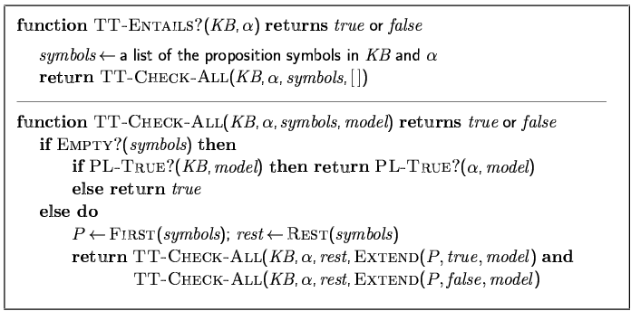
Inference by enumeration (truth tables)
Depth-first enumeration of all models is sound and complete
For n symbols, time complexity is O(2^{n}), space complexity is O(n)

Slide 43
Rules of inference
Logical inference is used to create new sentences that logically follow from a given set of sentences (KB).
An inference rule is sound if every sentence X produced by an inference rule operating on a KB logically follows from the KB.
The inference rule does not create any contradictions

Slide 44
Sound (correct) rules of inference
RULE PREMISE CONCLUSION
Modus Ponens A, A → B B
AND Introduction A, B A ∧ B
AND Elimination A ∧ B A
Double Negation ~~A A
Resolution A ∨ B, ~B ∨ C A ∨ C
Unit resolution A ∨ B, ~B A
Each can be shown to be sound/correct using a truth table

Slide 45
Modus ponens is sound
A | B | A → B
True | True | True
True | False | False
False | True | True
False | False | True
Premise: A, A → B
Conclusion: B
conclusion is true whenever the premise is true

Slide 46
Converse of modus ponens
RULE PREMISE CONCLUSION
Converse of MP A → B, ~A ~B
Is this sound?
A | B | ~A | ~B | A → B
True | True | False | False | True
True | False | False | True | False
False | True | True | False | True
False | False | True | True | True
Premise: ~A, A → B
Conclusion: ~B
conclusion is not true in all cases where the premise is true

Slide 47
Proofs
A proof is a sequence of sentences, where each sentence is either a premise or a sentence derived from earlier sentences in the proof by one of the rules of inference.
The last sentence is the theorem (also called goal or query) that we want to prove.

Slide 48
Example of a proof
Premises
Q
(P ∧ Q) → R
Q → P
How to prove?
R

Slide 49
Example of a proof
Q
Premise 1
Q → P
Premise 3
P
Modus ponens on 1 and 2
(P ∧ Q) → R
Premise 2
(P ∧ Q)
AND introduction on 1 and 3
R
Modus ponens on 4 and 5

Slide 50
Proof using rules of inference
Given
P →( Q→R)
Q
Does this follow?
P → R
Proof
P -> (~Q v R)
Rewriting Premise 1
~P v ~Q v R
Rewriting premise 1
~P v R
Resolution on ~P v ~Q v R and Q
P -> R

Slide 51
Automatic theorem proving
How to automatically prove a statement is true?
Method must be complete
Truth table
Complexity?
Resolution algorithm

Slide 52
Resolution
Disadvantages of our derivation method
Which rule of inference to apply?
Apply to which sentences?
Needed: an algorithm – can be executed by a computer
Alan Robinson, 1965
Most modern automated theorem provers use this

Slide 53
Resolution rule
RULE PREMISE CONCLUSION
Modus Ponens A, A → B B
AND Introduction A, B A ∧ B
AND Elimination A ∧ B A
Double Negation ~~A A
Resolution A ∨ B, ~B ∨ C A ∨ C
Unit resolution A ∨ B, ~B A
This single rule
is sufficient

Slide 54
Is resolution sound (correct)?
Show is sound/correct using a truth table

Slide 55
Class work
For each pair of sentences
Apply resolution and write the result
Or write that resolution cannot be applied
Note that in resolving two clauses, only one pair of literals may be resolved at a time (though there may be multiple resolvable pairs)
A ∨ ~C, A ∨ B ∨ C
A ∨ ~C, P ∨ Q ∨ ~R
A ∨ ~C, A ∨ B ∨ ~C
A ∨ B ∨ ~C, A ∨ ~B ∨ C,

Slide 56
Applying the resolution rule
First, Convert to Conjunctive Normal Form (CNF)
CNF: Knowledgebase (KB) is a conjunction of disjunctions
Example: (A ∨ B) ∧ (A ∨ ~C) ∧ (~B ∨ ~C)
KB can then be represented as a list of conjunctions:
A ∨ B
A ∨ ~C
~B ∨ ~C

Slide 57
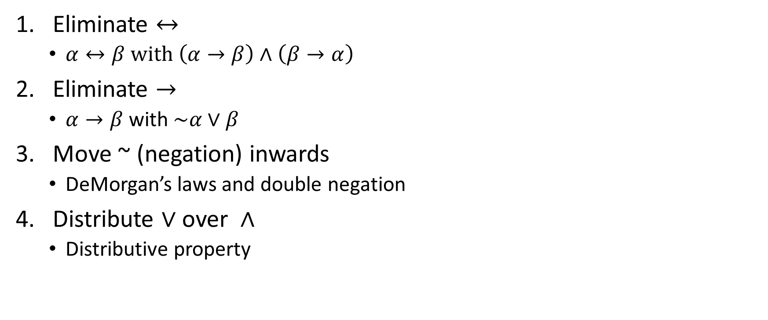
Convert to CNF
Eliminate $↔$
$α↔β with \left(α→β\right)∧\left(β→α\right)$
Eliminate $→$
$α→β$ with $\sim α∨β$
Move ~ (negation) inwards
DeMorgan’s laws and double negation
Distribute $∨$over $∧$
Distributive property

Slide 58


CNF: Eliminate $→$
$α→β$ is equivalent to $\sim α∨β$

Slide 59
CNF: Dealing with parentheses
DeMorgan’s laws
~(A ∨ B) ≡ ~A ∧ ~B
~(A ∧ B) ≡ ~A ∨ ~B
Distributive property
(A ∧ B) ∨ C ≡ (A ∨ C) ∧ (B ∨ C)

Slide 60
Examples: convert to CNF
~(~P ∨ Q)
~(~P ∨ Q) ∨ R
(P → Q) → R

Slide 61
Examples: convert to CNF
~(~P ∨ Q)
~~P ∧ ~Q
P ∧ ~Q
P
~Q
~(~P ∨ Q) ∨ R
(P ∧ ~Q) ∨ R
(P ∨ R) ∧ (~Q ∨ R)
P ∨ R
~Q ∨ R
(P → Q) → R

Slide 62
Proof by Resolution Refutation (proof by contradiction)
Input: KB (Premise), α
Output: α is a valid conclusion (KB → α), OR invalid (i.e., cannot be proved)
Convert all premise sentences (KB) to CNF
Add the negated conclusion (~α)
Repeatedly apply rule of resolution until
Derive FALSE (contradiction): Conclusion is valid
Can’t apply any more: Conclusion cannot be proved

Slide 63
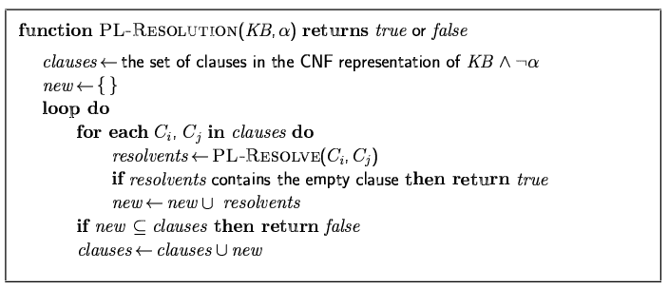
Resolution algorithm
Proof by contradiction, i.e., show KB∧¬α unsatisfiable Resolution is sound and complete for propositional logic

Slide 64
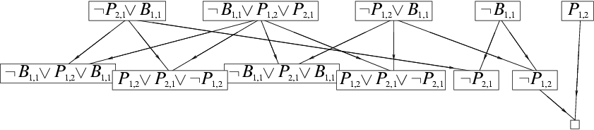
Resolution example
KB = (B_{1,1} ⇔ (P_{1,2}∨ P_{2,1})) ∧¬ B_{1,1}
α = ¬P_{1,2}

Slide 65
Example 1
Premise:
P ∨ Q
P → R
Q → R
Prove:
R

Slide 66
Example 2
Premise:
P ∨ Q
P → R
Q → R
Prove:
~R

Slide 67
Classwork
Given
P →( Q→R)
Q
Does this follow?
P → R
Use
Resolution

Slide 68
Classwork
Given
P →( Q→R)
Q
Does this follow?
P
Use
Resolution

Slide 69
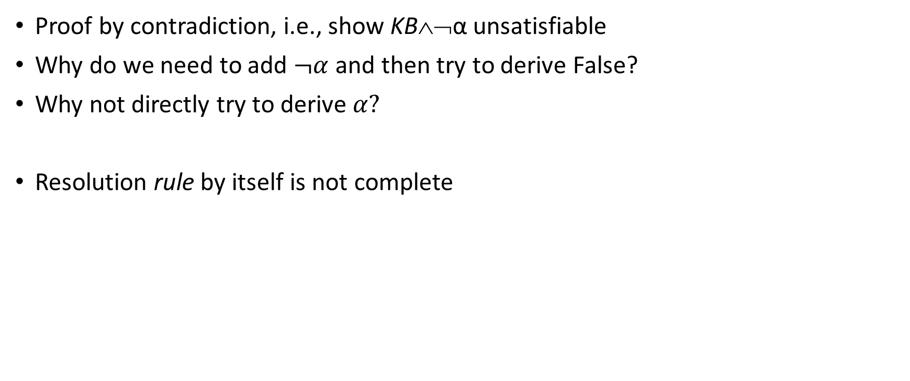
Resolution algorithm
Proof by contradiction, i.e., show KB∧¬α unsatisfiable Why do we need to add $¬α$and then try to derive False?
Why not directly try to derive $α?$
Resolution rule by itself is not complete

Slide 70
Proof by Resolution Refutation
Sound
The answer is always correct
Complete
It always generates an answer

Slide 71
Efficient proofs
Not every application of resolution is needed
Unit preference
prefer a resolution step involving an unit clause (clause with one literal)
Produces a shorter clause
Set of support
Choose a resolution involving the negated goal or any clause derived from the negated goal

Slide 72
Implementing the algorithm
How to represent the KB?
Bitwise representation of CNF

Slide 74
Wumpus world logic
Develop a propositional logic system to decide where to move
What propositions?

Slide 75

Wumpus world logic variables
$P_{x,y}$: pit in (x,y)
$W_{x,y}$: wumpus in (x,y)
$B_{x,y}$: agent perceives breeze in (x,y)
$S_{x,y}$: agent perceives stench in (x,y)

Slide 76
Wumpus world logic
Develop a propositional logic system to decide where to move
What variables?
How to represent:
S11 = None ⇒ S12 = Safe ∧ S21 = Safe

Slide 77
Inference-based agents in the wumpus world
A wumpus-world agent using propositional logic:
¬P_{1,1}
¬W_{1,1}

Slide 78
Inference-based agents in the wumpus world
A wumpus-world agent using propositional logic:
¬P_{1,1}
¬W_{1,1}
Rules for breeze and stench?

Slide 79
Inference-based agents in the wumpus world
A wumpus-world agent using propositional logic:
¬P_{1,1}
¬W_{1,1}
Rules for breeze and stench:
B_{x,y} ⇔ (P_{x,y+1} ∨ P_{x,y-1} ∨ P_{x+1,y} ∨ P_{x-1,y})
S_{x,y} ⇔ (W_{x,y+1} ∨ W_{x,y-1} ∨ W_{x+1,y} ∨ W_{x-1,y})

Slide 80
Inference-based agents in the wumpus world
A wumpus-world agent using propositional logic:
¬P_{1,1}
¬W_{1,1}
B_{x,y} ⇔ (P_{x,y+1} ∨ P_{x,y-1} ∨ P_{x+1,y} ∨ P_{x-1,y})
S_{x,y} ⇔ (W_{x,y+1} ∨ W_{x,y-1} ∨ W_{x+1,y} ∨ W_{x-1,y})
Exactly one wumpus?

Slide 81
Inference-based agents in the wumpus world
A wumpus-world agent using propositional logic:
¬P_{1,1}
¬W_{1,1}
B_{x,y} ⇔ (P_{x,y+1} ∨ P_{x,y-1} ∨ P_{x+1,y} ∨ P_{x-1,y})
S_{x,y} ⇔ (W_{x,y+1} ∨ W_{x,y-1} ∨ W_{x+1,y} ∨ W_{x-1,y})
Exactly one wumpus:
W_{1,1} ∨ W_{1,2} ∨ … ∨ W_{4,4}
¬W_{1,1} ∨ ¬W_{1,2}
¬W_{1,1} ∨ ¬W_{1,3}

Slide 82
Inference-based agents in the wumpus world
A wumpus-world agent using propositional logic:
¬P_{1,1}
¬W_{1,1}
B_{x,y} ⇔ (P_{x,y+1} ∨ P_{x,y-1} ∨ P_{x+1,y} ∨ P_{x-1,y})
S_{x,y} ⇔ (W_{x,y+1} ∨ W_{x,y-1} ∨ W_{x+1,y} ∨ W_{x-1,y})
W_{1,1} ∨ W_{1,2} ∨ … ∨ W_{4,4}
¬W_{1,1} ∨ ¬W_{1,2}
¬W_{1,1} ∨ ¬W_{1,3}
…
⇒ 64 distinct proposition symbols, 155 sentences

Slide 83
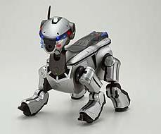

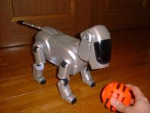

Embedding reasoning into a Sony Aibo robot

Slide 84
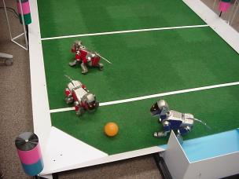
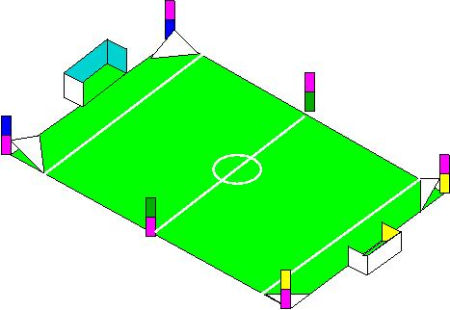
Embedding reasoning into a Sony Aibo robot

Slide 85
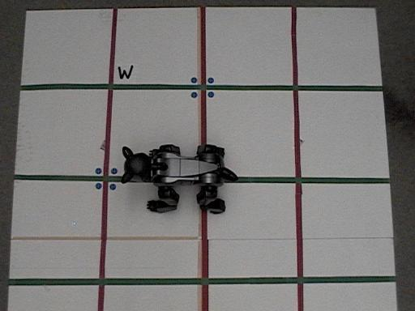
Embedding reasoning into a Sony Aibo robot
reasoning algorithms based on PL could be executed even on low-power computer platforms if
efficient representation of Boolean propositions are used
The plan to solve the Wumpus world problem is computed offline and stored as an Ordered Binary Decision Diagram (OBDD) in the robot's memory.

Slide 86
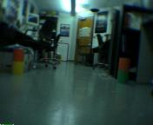
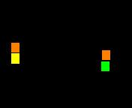
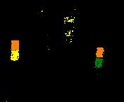
Embedding reasoning into a Sony Aibo robot
The robot uses its vision system to identify its location in the grid world
then instantiates the appropriate variables in the OBDD.

Slide 87
Embedding reasoning into a Sony Aibo robot
The instantiated action variable determines the direction in which the robot is to move.

Slide 88
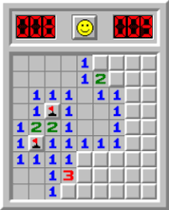
Classwork: Minesweeper
Minesweeper is related to the Wumpus world.
The minesweeper world is a rectangular grid with invisible mines scattered around it. Any cell may be probed by the player; instant death follows if a mine is probed. Minesweeper indicates the presence of mines by revealing, in each probed cell, the number of mines that are directly or diagonally adjacent. The goal is to probe every unmined cell.
Let proposition Xij = True (where i=0,1,2,… and j=0,1,2,…) denote that cell (i,j) contains a mine.
Let probing the corner cell (0,0) reveal 1 mine in an adjacent cell. How can the assertion that exactly one mine is adjacent to (0,0) be expressed in Propositional logic (as some logical combination of the Xij propositions)?

Slide 89
Class work
Represent the following scenario using Propositional Logic
KB: “CPSC375 has CPSC131 and MATH338 as prerequisites. CPSC481 has CPSC375 and MATH338 as prerequisites. A course can only be taken if all the prerequisites have been taken.”
Query 1a: A student has taken CPSC131. Can this student take CPSC375?
Query 1b: A student has taken CPSC131. Can this student take CPSC481?
Query 2a: A student has taken CPSC131 and MATH338. Can this student take CPSC375?
Query 2b: A student has taken CPSC131 and MATH338. Can this student take CPSC481?

Slide 90
Applications of Propositional Logic
Software verification
Verification of trajectory planners used in automotive and robotic driving
Compilers/assemblers
CPU register allocation (for individual functions)
Verifying alternate instruction sets
Verifying operations of floating point numbers
Bitcoin mining
Proceedings of SAT Competition 2023: Solver, Benchmark and Proof Checker Descriptions

Slide 91
Logictools.org
https://logictools.org/prop.html
https://logictools.org/about.html#prop_syntax

Slide 92
Expressiveness limitation of propositional logic
KB contains "physics" sentences for every single square For every time t and every location [x,y], L_{x,y} ∧ FacingRight^{t} ∧ Forward^{t} ⇒ L_{x+1,y}
Rapid proliferation of clauses

Slide 93
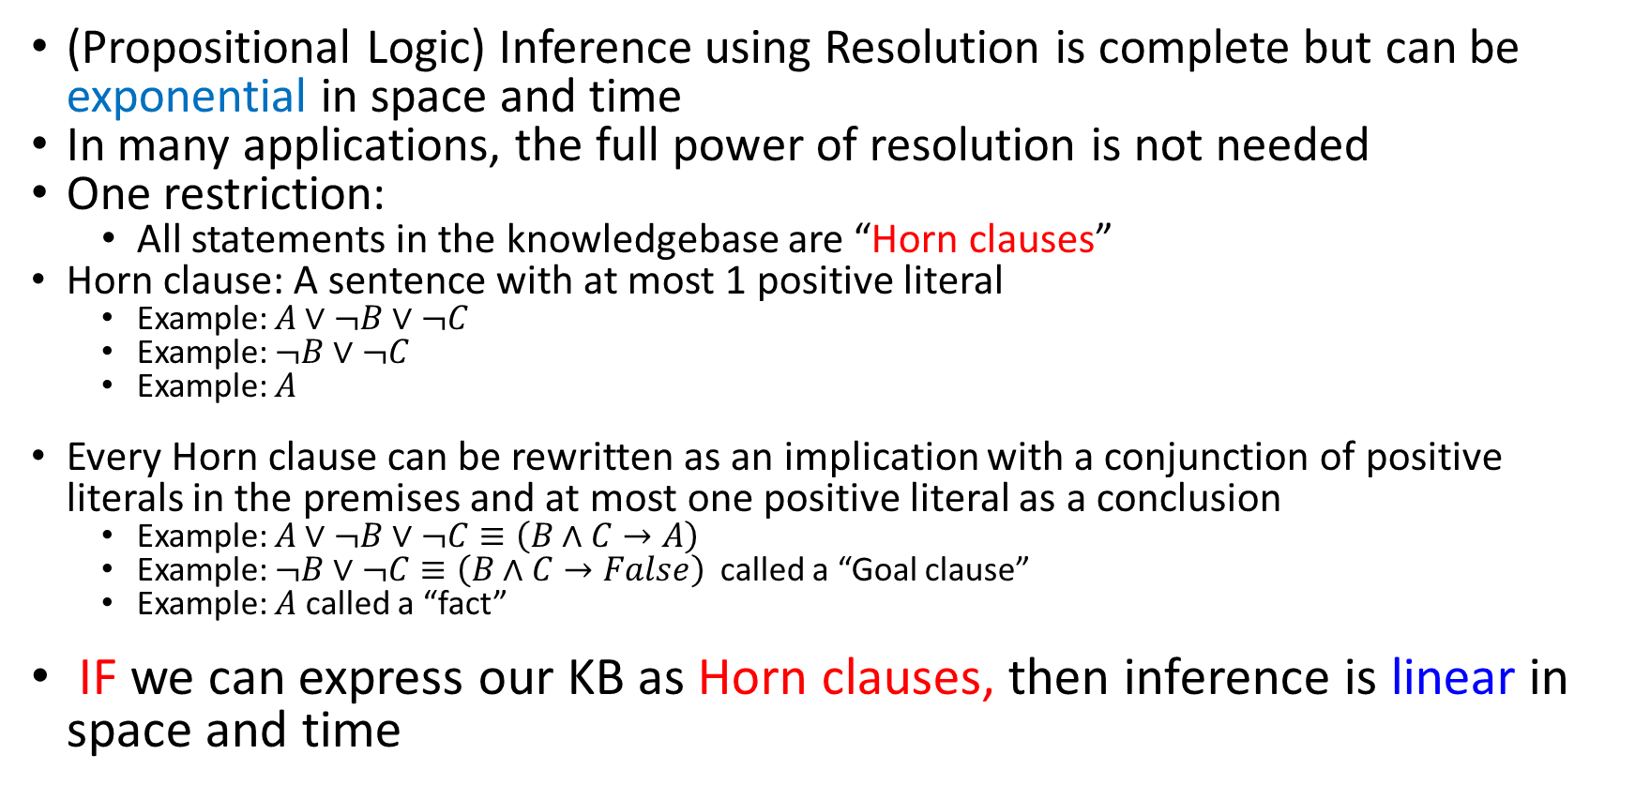
Horn Clauses
(Propositional Logic) Inference using Resolution is complete but can be exponential in space and time
In many applications, the full power of resolution is not needed
One restriction:
All statements in the knowledgebase are “Horn clauses”
Horn clause: A sentence with at most 1 positive literal
Example: $A∨¬B∨¬C$
Example: $¬B∨¬C$
Example: $A$
Every Horn clause can be rewritten as an implication with a conjunction of positive literals in the premises and at most one positive literal as a conclusion
Example: $A∨¬B∨¬C≡\left(B∧C→A\right)$
Example: $¬B∨¬C≡\left(B∧C→False\right)$ called a “Goal clause”
Example: $A$ called a “fact”
IF we can express our KB as Horn clauses, then inference is linear in space and time

Slide 94
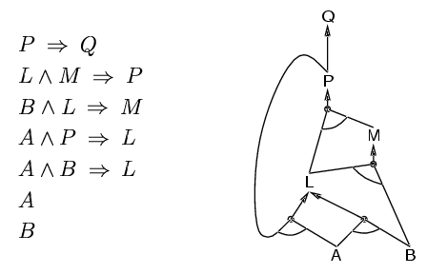
Forward chaining (FC)
Idea: fire any rule whose premises are satisfied in the KB, add its conclusion to the KB, until Query is found.
This proves that KB ⇒ Query is true
AND
To prove: Q
OR
Forward chaining is sound and complete for Horn KB

Slide 95
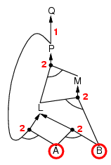
Forward chaining example
Numbers at each AND node indicate the number of outstanding preconditions yet to be satisfied before all of that AND node input preconditions have been satisfied. It is an efficient book-keeping mechanism for determining when an AND node is satisfied. The AND node is satisfied when its number of outstanding preconditions yet to be satisfied is zero.
“OR” Gate
“AND” gate

Slide 96
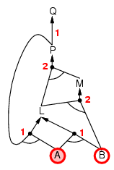
Forward chaining example

Slide 97
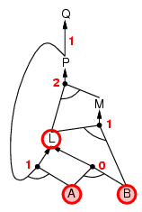
Forward chaining example

Slide 98
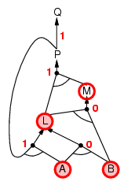
Forward chaining example

Slide 99
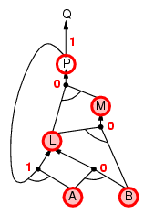
Forward chaining example

Slide 100
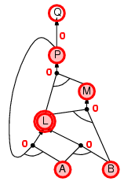
Forward chaining example

Slide 101
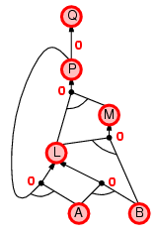
Forward chaining example

Slide 102
Forward v. Backward chaining
Forward chaining is reasoning from facts to the conclusions resulting from those facts
In the Wumpus world:
Start from facts: stench(1,2)
Conclude: wumpus(2,2)
CLIPS
Backward chaining involves reasoning in reverse from a hypothesis - from a potential conclusion to be proved, to the facts that support the hypothesis
Start from goal: does square (2,2) contain the wumpus?
Backwards reasoning: Is so, then stench(1,2) V stench(2,1)? …
PROLOG

Slide 103
Contradiction in the premise
Premise:
P
~P
Prove:
C

Slide 104
Contradiction in the premise
P ∧ ~P → C is valid
Any conclusion can be proved from a contradiction
Pure logic systems are brittle

